Slide 1

Bike Sharing Demand Analysis

Slide 2
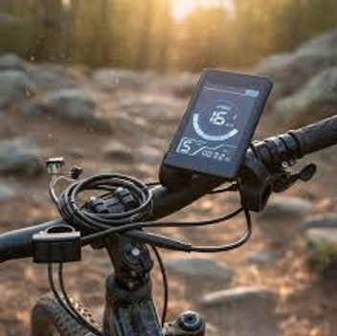
Analysis Bike Sharing Demand Analysis
Agenda
Problem and objective
Data, cleaning and methods
Key performance indicators
Demand by hour, weekday and weather
User mix: casual vs. registered
Daily trend, forecast and anomalies
Dashboard and recommendations

Slide 3

Problem and Objective
Understand how time, weather and holidays affect bike rentals.
Combine hourly rental, weather and user-type data into one clean dataset.
Find demand patterns that improve fleet and business planning.
Build an automated, interactive reporting workbook.

Slide 4

Methods Used
Power Query: Merge (instant), Append, remove duplicates and nulls, set data types.
Missing Assume Temperature values filled; columns renamed.
New columns: Weekday name, Day Type, Weather Status, Weather Desc.
Functions: SUM, AVERAGE, MIN, MAX, COUNT, IF, VLOOKUP, HLOOKUP, INDEX-MATCH, COUNTIF, SUMIF, STDEV, CORREL.
PivotTables, Pivot Charts, slicers, Forecast Sheet, anomaly detection, VBA macros.

Slide 5

Key Performance Indicators
4,921
Casual Users
249
Max Hourly Demand
58.30
Avg Hourly Demand
58,304
Total Rentals
53,383
Registered Users

Slide 6
Hourly Demand
  Peaks at 17:00 (avg 140) and18:00 (avg 123).
Second peak at 08:00 (avg 128).
Commuter pattern; very low 01:00 to 05:00.

Slide 7
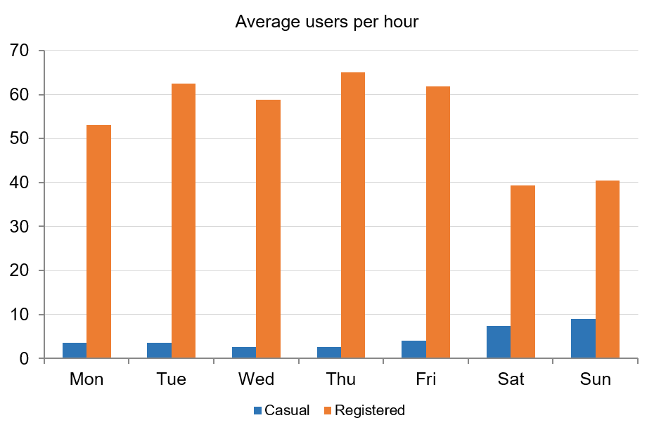
Casual vs RegistereCasual vs Registered by Weekday
Casual Vs Registered by Weekday
Registered users dominate Tue to Fri (about 59 to 65).
Casual users peak on Sunday (9.0) and Saturday (7.4).
Weekdays = commuting; weekends = leisure.

Slide 8
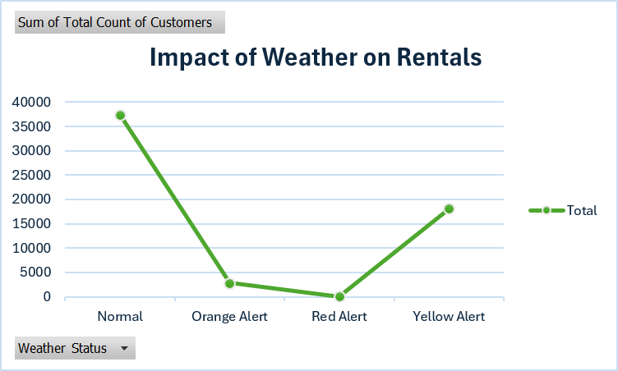
Impact of Weather on Rentals
Normal: 37,373 rentals.
Yellow Alert: 18,106.
Orange Alert: 2,789; Red Alert: only 36.
Demand falls sharply as alert level rises.

Slide 9

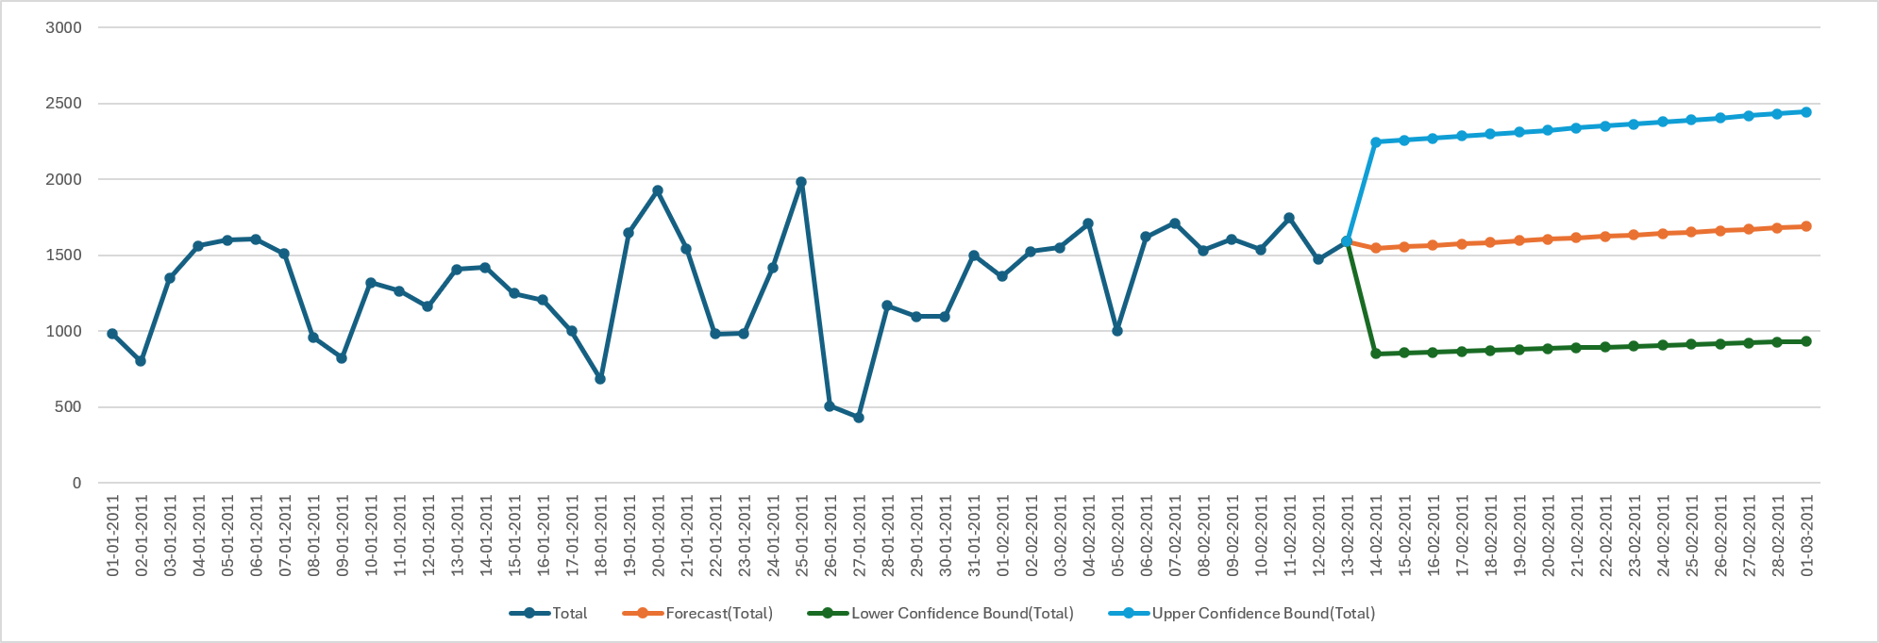
Forecast and Anomaly Detection
Flagged: more than 2 standard deviations from the mean.
26-01 (506) and 27-01 (431): low demand, likely weather.
14-02 (151): partial day of data.
Forecast Sheet projects demand with a 95% confidence band.

Slide 10
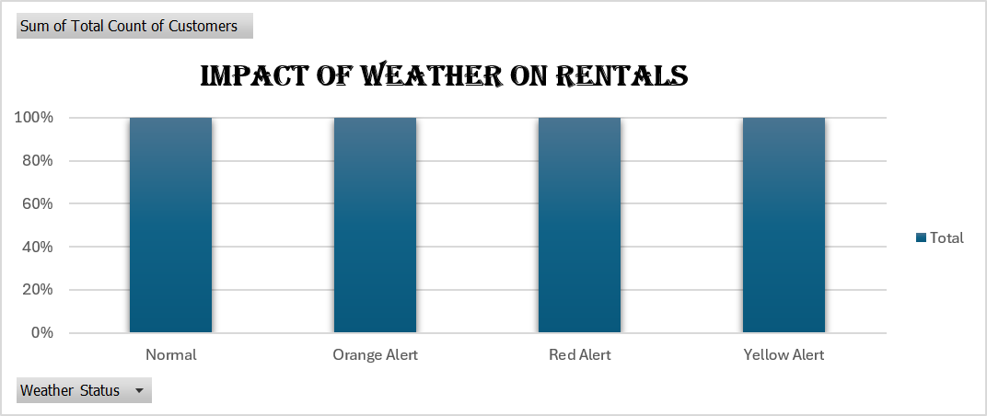
Weather Share of Demand
Normal weather: 64%.
Yellow Alert: 31%.
Orange and Red together: about 5%.
Plan fleet size by weather forecast.

Slide 11
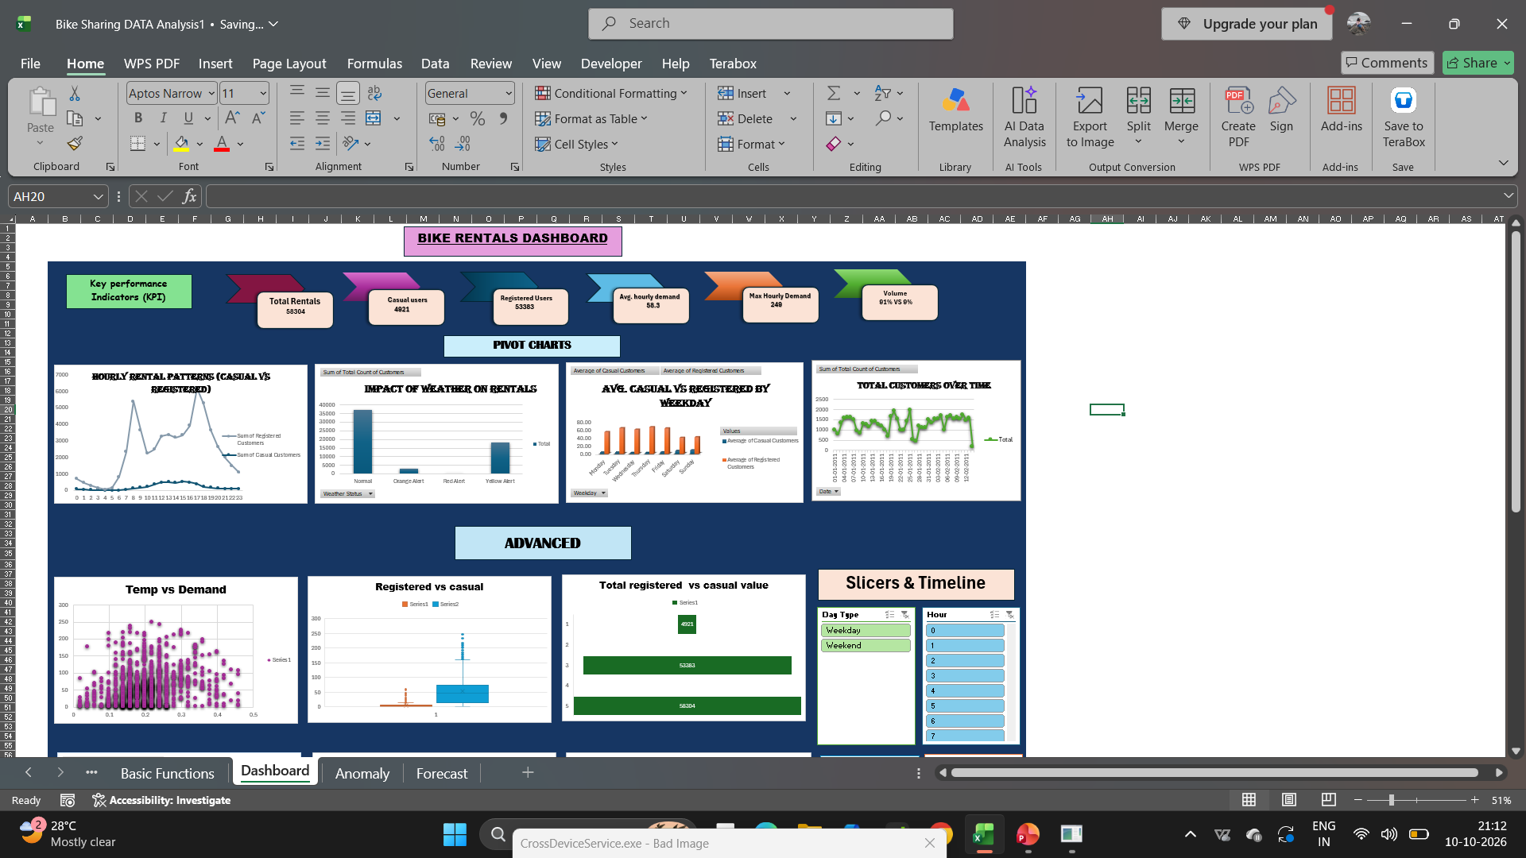
Interactive Dashboard
KPI cards and 4 pivot charts.
Advanced charts: funnel, doughnut, scatter.
Slicers: Weekday, Day Type, Weather Status, Hour.
Timeline filter on Date.
Macro buttons: Refresh Report, Reset Filters.

Slide 12
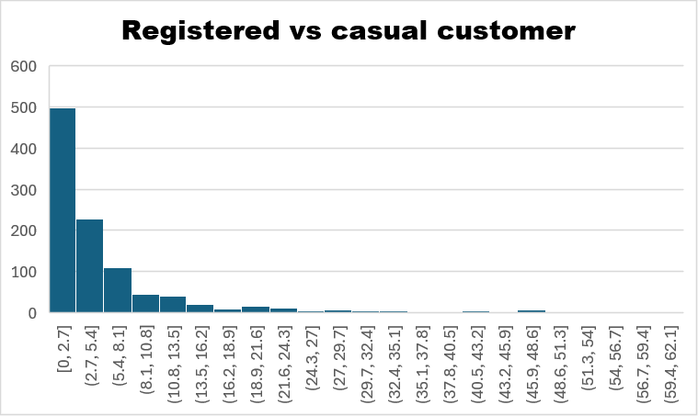
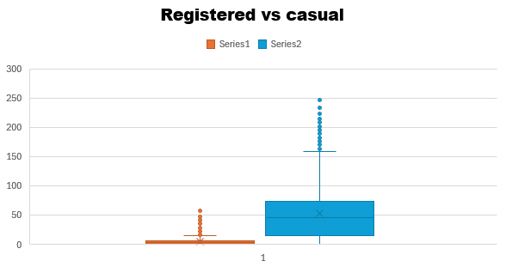
Casual vs Registered Users

Slide 13
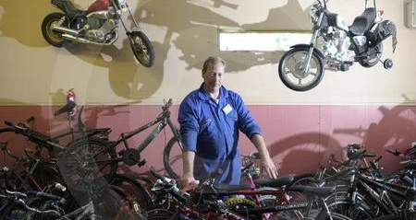
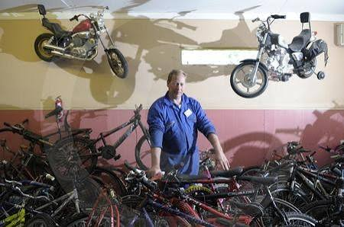

Slide 14

Recommendations and Conclusion
Stock more bikes at 08:00 and 17:00 to 18:00 on weekdays.
Run weekend offers to convert casual users to registered.
Reduce bike supply on Orange and Red alert days.
Validate incomplete days before forecasting.
Macros automate refresh, anomaly marking and filter reset.

Slide 15


